Slide 1
Unit 5 – Correlation
and
Simple Linear Regression

Slide 2
Bivariate Data
●
Bivariate data is when you are studying two variables. For example:
Weights and heights of college students.
Bivariate data could also be two sets of items that are dependent on each other. For example:
Ice cream sales compared to the temperature that day.
Traffic accidents along with the weather on a particular day.
Bivariate data has many practical uses in real life. For example:
It is pretty useful to be able to predict when a natural event might occur.
●
●

Slide 3
Bivariate Analysis
●
Bivariate analysis means the analysis of bivariate data; used to find out if there is a relationship between two sets of values.
●
It usually involves the variables X and Y, denoted as (X, Y).
●
With bivariate analysis, there is a Y value for each X.
●
The results from bivariate analysis are usually stored in a two-column data table.

Slide 4
Dependent(Y) and independent(X) variables
●
The dependent variables represent the output or outcome whose variation is being studied. [most common symbol for the input is x]
●
The independent variables represent inputs or causes, i.e. potential reasons for variation. [most common symbol for the output is y]
●
Models test or explain the effects that the independent variables have on the dependent variables. [ y = f(x) ]
●
It is possible to have multiple independent variables and/or multiple dependent variables.

Slide 5
Identify Dependent and independent variables
Relationship between caloric intake and weight.
Effect of temperature on pigmentation.
Effect of drug dosage on symptom severity.
Effect of fertilizer on plant growth.

Slide 6
Solution : Dependent and independent variables
Independent Variable (X) | Dependent Variable (Y)
1. Caloric intake | Weight
2. Temperature | Pigmentation
3. Drug Dosage | Frequency/intensity of symptoms
4. Amount of fertilizer used | Growth in height or mass of the plant

Slide 7
Note
●
Depending on the context, an independent variable is sometimes called a "predictor variable", "regressor", "controlled variable", "manipulated variable", "explanatory variable", or "input variable."
●
Depending on the context, a dependent variable is sometimes called a "response variable", "regressand", "predicted variable", "measured variable", "explained variable", "experimental variable", "responding variable", "outcome variable", or "output variable"

Slide 8
Types of Bivariate Analysis

Slide 9
Types of Bivariate Analysis
Scatter plots : gives you a visual idea of the pattern that your variables follow.
Correlation Coefficients : This coefficient tells you if the variables are related. Refers to the extent to which two variables have a linear relationship with each other.
3. Regression Analysis : Regression analysis helps provide an equation for the curve or line that depicts pattern that your variables follow.
It can also give you the correlation coefficient.
It is a statistical process for estimating the relationships among variables.
●
●

Slide 10
Note:
The methods described here work only when there exists a linear relationships between bivariate data.

Slide 11
Correlation

Slide 12
Correlation
Correlation is any of a broad class of statistical relationships involving dependence; commonly refers to the extent to which two variables have a linear relationship with each other (or related to each other).
●
●
Correlations are useful because they can indicate a
predictive relationship that can be exploited in practice.
●
There are several correlation coefficients that measure the degree of correlation.

Slide 13
Pearson's correlation coefficient
The most familiar measure of dependence between two quantities is the Pearson product-moment correlation coefficient, or "Pearson's correlation coefficient", commonly called simply "the correlation coefficient".
●
Correlation coefficient detects only linear dependencies between two variables.
●
●
If the variables are independent, Pearson's correlation coefficient is 0.

Slide 14
Population Pearson correlation coefficient – ρ
For a population, Pearson's correlation coefficient when applied to a population is commonly represented by the Greek letter ρ (rho) and may be referred to as the population correlation coefficient or the population Pearson correlation coefficient.
Sample Pearson correlation coefficient – r
Pearson's correlation coefficient when applied to a sample is commonly represented by the letter r and may be referred to as the sample correlation coefficient or the sample Pearson correlation coefficient.

Slide 15
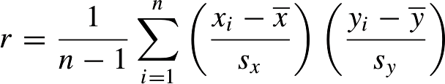
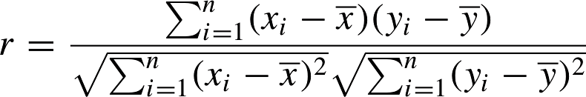
Sample Pearson correlation coefficient - r
Expanding s_{x} and s_{y} ,

Slide 16



Computing Formulas
1.
2.
3.

Slide 17
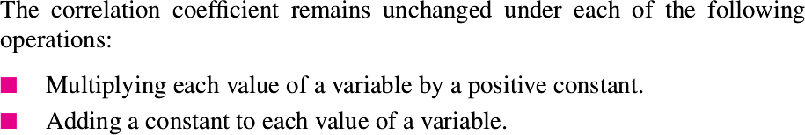
Points to Ponder
●
The absolute values of both the sample and population Pearson correlation coefficients are less than or equal to 1.
Correlations equal to 1 or −1 correspond to data points lying exactly on a line.
The Pearson correlation coefficient is symmetric:
corr(X,Y) = corr(Y,X)
Correlation coefficient is invariant to separate changes in location and scale in the two variables.
●
●
●

Slide 18
Working of Correlation Coefficient
The correlation coefficient is positive if X_{i} and Y_{i} tend to be simultaneously greater than, or simultaneously less than, their respective means.
●
The correlation coefficient is negative if X_{i} and Y_{i} tend to lie on opposite sides of their respective means.
●

Slide 19
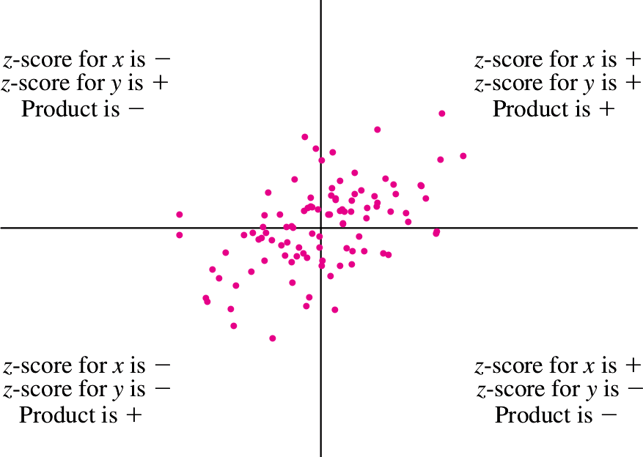

Slide 20
Problem 1
An investigator collected data on heights and weights of college students.
The correlation between height and weight for men was about 0.6, and for women it was about the same.
If men and women are taken together, will the correlation between height and weight be more than 0.6, less than 0.6, or about equal to 0.6?
●
●
●

Slide 21
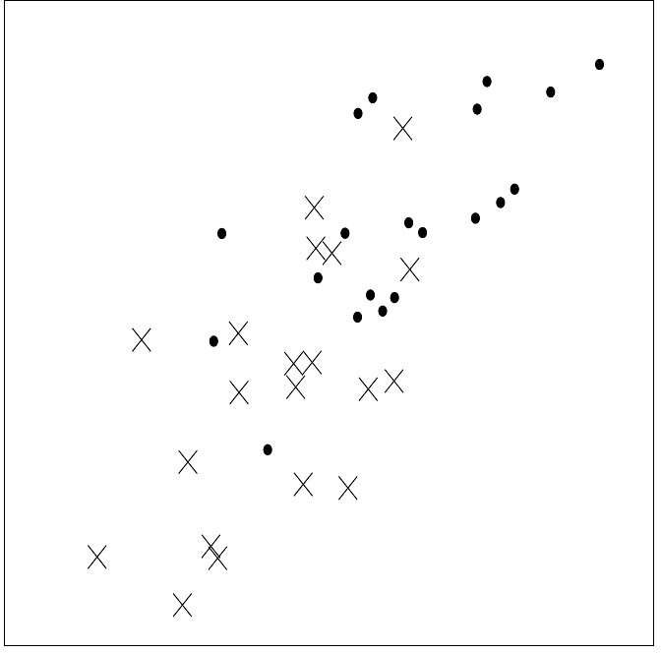
Problem 1 : Solution
●
(dot) represents height and weight of men
x (cross) represents height and weight of women

Slide 22
Problem 1 : Solution
The heights and weights for the men (dots) are on the whole greater than those for the women (xs).
Therefore the scatterplot for the men is shifted up and to the right.
The overall plot exhibits a higher correlation than either plot separately.
The correlation between heights and weights for men and women taken together will be more than 0.6.
●
●
●
●

Slide 23
Correlation does not imply causation

Slide 24
Correlation does not imply causation
Correlation cannot be used to infer a causal relationship between the variables.
In other words, a correlation can be taken as evidence for a possible causal relationship, but cannot indicate what the causal relationship, if any, might be.
●
●

Slide 25
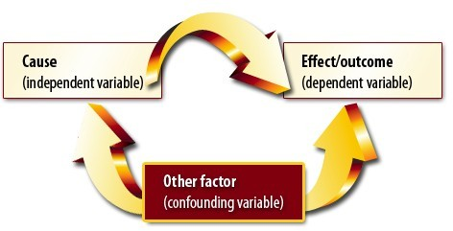
Example : Relationship between reading ability and shoe size. (Strong Positive Correlation).
This does not mean large shoes cause good reading skills.
The part age plays in this example is known as a "confounding variable" or "confounding factor," and is something that is not being controlled for in the experiment.

Slide 26
Confounding
Something that interferes with or obscures your research.
A confounding variable is an “extra” variable that you didn’t account for.
They can ruin an experiment and give you useless results. They can suggest there is correlation when in fact there isn’t.
Confounding variables can cause two major problems:
Increase variance
Introduce bias.
A confounding variable are like extra independent variables that are having a hidden effect on your dependent variables.
A confounding variable can be what the actual cause of a correlation is, hence any studies must take these into account and find ways of dealing with them.
●
●
●
●
●
●

Slide 27
MURDER AND ICE CREAM
It is known that throughout the year, murder rates and ice cream sales are highly positively correlated. There are three possible explanations for this correlation:
Possibility #1: Murders cause people to purchase ice cream.
Possibility #2: Purchasing ice cream causes people to murder or get murdered.
Possibility #3: There is a third variable—a confounding variable—which causes the increase in BOTH ice cream sales AND murder rates. For instance, the weather.

Slide 28
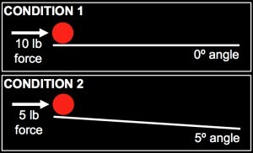
Relationship between the force you apply to a ball and the distance the ball travels.
●
Naturally, you predict that the more force you apply, the further the ball will travel.
After you run your experiment, you observe that the ball travels further in Condition 2 than it does in Condition 1.
In other words, you find that the less force you apply, the further the ball travels.
No, there’s a clear confounding variable in this experimental design: the angle of the slope.
●
●
●

Slide 29
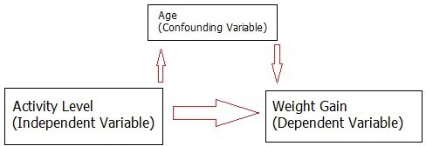
Example : Relationship between Physical activity and weight gain.
●
One confounding variable is how much people eat. It’s also possible that men eat more than women; this could also make sex a confounding variable.
Nothing was mentioned about starting weight, occupation or age either. A poor study design like this could lead to bias.
For example, if all of the women in the study were middle-aged, and all of the men were aged 16, age would have a direct effect on weight gain.
That makes age a confounding variable.
●
●
●
●

Slide 30
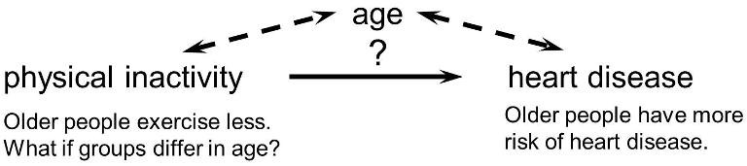
Example : Strength of association between physical inactivity and heart disease.
●
Age is a confounding factor because it is associated with the exposure (meaning that older people are more likely to be inactive), and it is also associated with the outcome (because older people are at greater risk of developing heart disease).
●
Or, if the age distribution is similar in the exposure groups being compared, then age will not cause confounding.

Slide 31
Problem
●
An environmental scientist is studying the rate of absorption of a certain chemical into skin.
She places differing volumes of the chemical on different pieces of skin and allows the skin to remain in contact with the chemical for varying lengths of time.
She then measures the volume of chemical absorbed into each piece of skin.
She obtains the results shown in the following table.
●
●
●

Slide 32
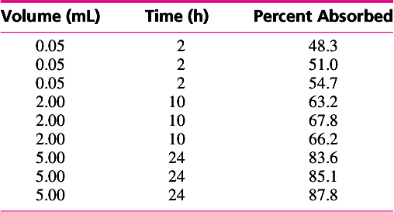
The scientist plots the percent absorbed against both volume and time. She wants to determine whether it is the time or the volume that is having an effect.

Slide 33
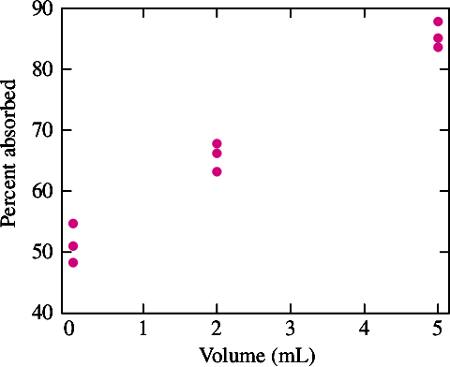
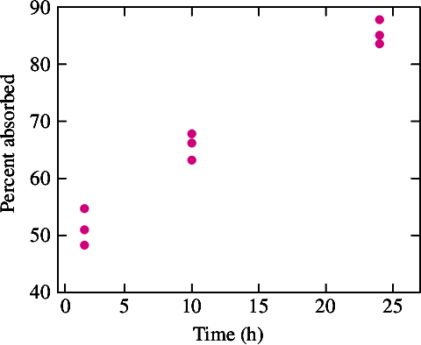
r = 0.988 r = 0.987
●
She concludes that increasing the volume of the chemical causes the percentage absorbed to increase.
She concludes that increasing the time that the skin is in contact with the chemical causes the percentage absorbed to increase as well.
●

Slide 34
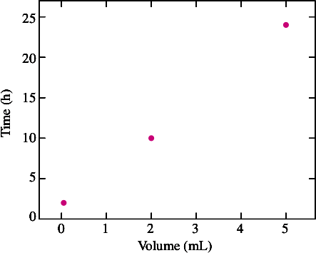
Are these conclusions justified?
●
If either time or volume affects the percentage absorbed, both will appear to do so, because they are highly correlated with each other.
For this reason, it is impossible to determine whether it is the time or the volume that is having an effect.
This relationship between time and volume resulted from the design of the experiment and should have been avoided.
●
●
r = 0.999

Slide 35
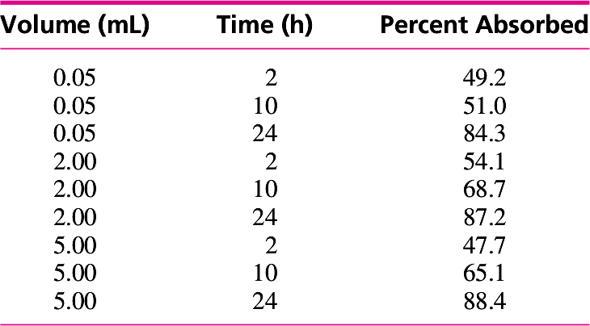
The scientist in has repeated the experiment, this time with a new design.

Slide 36
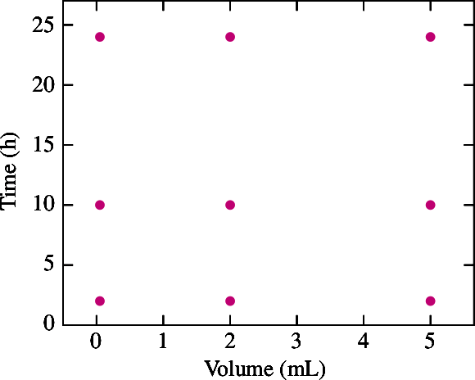
Time and Volume uncorrelated

Slide 37
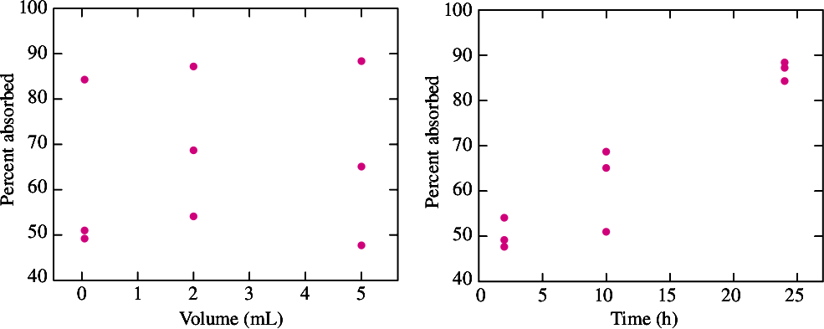
r = 0.121 r = 0.952
She concludes that increasing the time that the skin is in contact with the chemical will cause the percentage absorbed to increase.

Slide 38
Is the conclusion justified?
●
Before making a final conclusion that increasing the time actually causes the percentage absorbed to increase, the scientist must make sure that there are no other potential confounders around.

Slide 39
Controlled Experiments Reduce the Risk of Confounding
Observational studies are studies in which the values of factors cannot be chosen by the experimenter. Studies involving public health issues, such as the effect of environmental pollutants on human health, are usually observational, because experimenters cannot deliberately expose people to high levels of pollution. In these studies, confounding is often difficult to avoid.
●
In controlled experiments, confounding can often be avoided by choosing values for factors in a way so that the factors are uncorrelated.
●

Slide 40
Correlation and linearity
Importance of visual examination of the data

Slide 41
Correlation and linearity
●
Correlation Coefficient Measures Only Linear Association, and its value does not completely characterize the relationship.
●
Correlation coefficient, as a summary statistic, cannot replace visual examination of the data.

Slide 42
Importance of visual examination of the data
●
The four y variables have the same mean (7.5), variance (4.12), correlation (0.816) and regression line (y = 3 + 0.5x).
However, the distribution of the variables is very different.
●

Slide 43
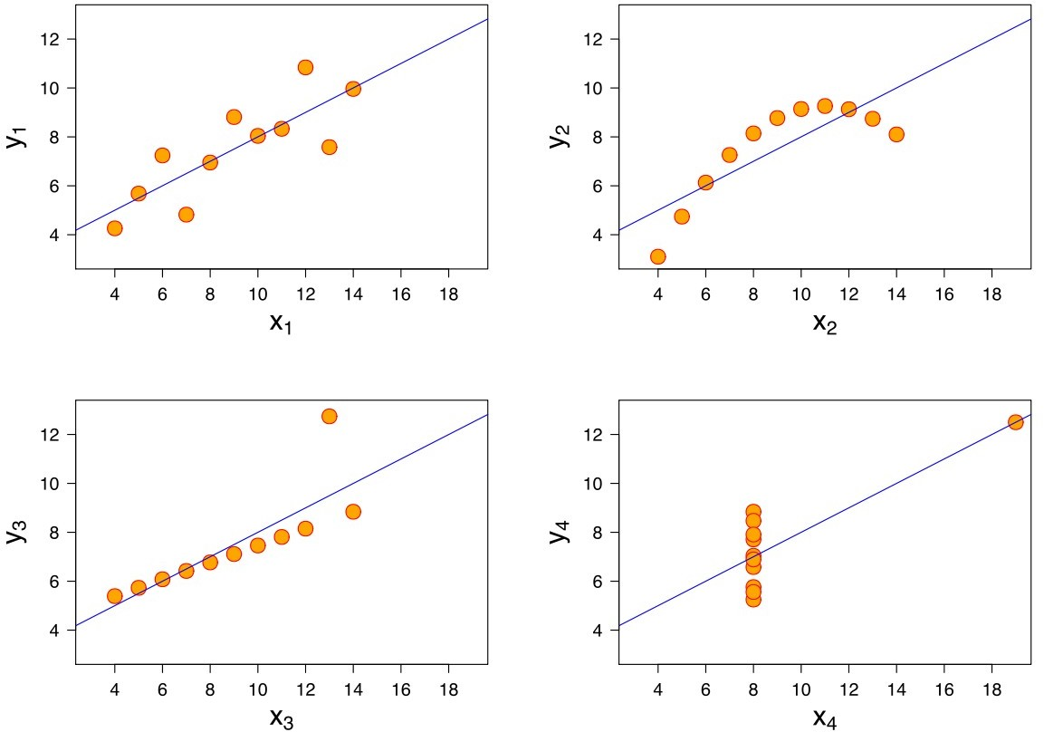
Prof. Preet Kanwal

Slide 44
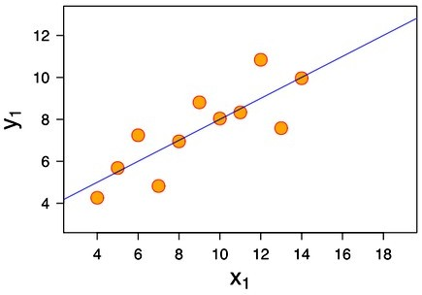
The first one (top left) seems to be distributed normally, and corresponds to what one would expect when considering two variables correlated and following the assumption of normality.

Slide 45
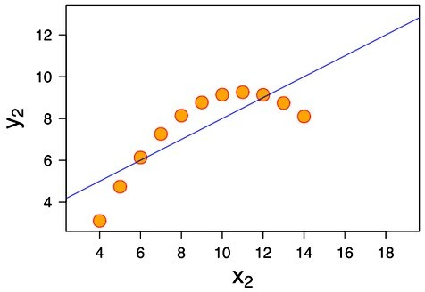
The second one is not distributed normally; while an obvious relationship between the two variables can be observed, it is not linear.
●
●
In this case the Pearson correlation coefficient does not indicate that there is an exact functional relationship: only the extent to which that relationship can be approximated by a linear relationship.

Slide 46
Correlation Coefficient - Misleading when outliers are present

Slide 47
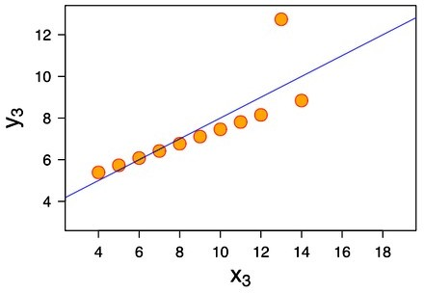
In the third case (bottom left), the linear relationship is perfect, except for one outlier which exerts enough influence to lower the correlation coefficient from 1 to 0.816.

Slide 48
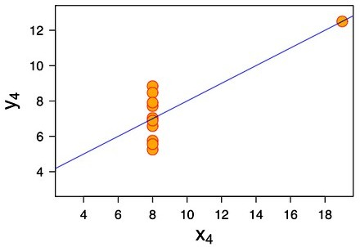
The fourth example (bottom right) shows another example when one outlier is enough to produce a high correlation coefficient, even though the relationship between the two variables is not linear.

Slide 49
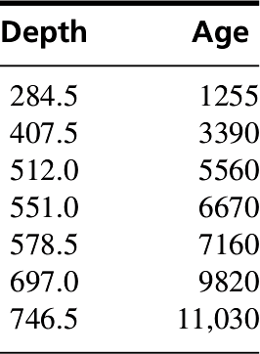
Problem 2
●
An article presents calculations of the ages (in calendar years before 1950) of several sediment samples taken at various depths (in cm) in Lago di Fimon, a lake in Italy. The results are presented in the following table.
1) Construct a scatterplot of age (y) versus depth (x).
Is the correlation coefficient an appropriate summary for these data? Explain why or why not.
Compute the correlation between depth(x) and age(y).

Slide 50
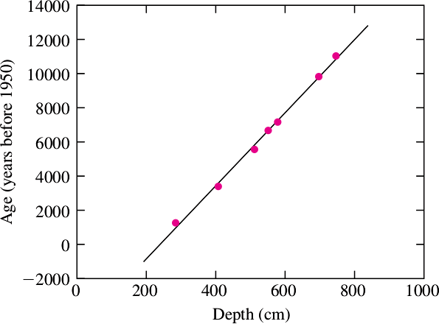
1) Construct a scatterplot of age (y) versus depth (x).

Slide 51
Problem 2 : Solution
Is the correlation coefficient an appropriate summary for these data? Explain why or why not.
Yes it is, as relationship between the two variables is linear.
Compute the correlation between depth(x) and age(y).
X_bar = 539.57
Y_bar = 6412.1
Sx = 159.43
Sy = 3416.1

Slide 52
3)Compute the correlation between depth(x) and age(y).
= 152513.71
Sqrt(152513.71) = 390.53
= 70019492.86
Sqrt(70019492.86) = 8367.77

Slide 53
3)Compute the correlation coefficient
= 3255209.921
= 0.996
3255209.921
= -------------------------- = 0.996 390.53 * 8367.77

Slide 54
Regression Analysis – Simple Linear Regression

Slide 55
Introduction
Regressions are used to quantify the relationship between one variable(dependent variable) and the other variables(independent variables) that are thought to explain it.
●
Regression analysis is an important tool for modelling and analyzing data.
●
●
Here, we fit a curve / line to the data points, in such a manner that the differences between the distances of data points from the curve or line is minimized.

Slide 56
Benefits of Using Regression Analysis
●
It indicates the significant relationships between dependent variable and independent variable.
●
It indicates the strength of impact of (multiple) independent variable(s) on a dependent variable.

Slide 57
Types of Regression Analysis
●
There are various kinds of regression techniques available to make predictions.
These techniques are mostly driven by three metrics :
Number of independent variables
Type of dependent variables(Continuous or Binary)
Shape of regression line.
●

Slide 58
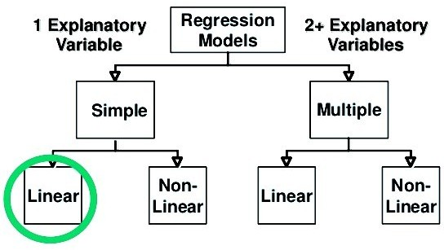
Types of Regression Analysis
1 Independent Variable
>1 Independent Variable

Slide 59
Types of Regression Analysis
1) Linear Regression :
In this technique, the dependent variable is continuous, independent variable(s) can be continuous or discrete, and nature of regression line is linear.
Power of independent variable = 1. Linear equation has one basic form.
●
●
●
2) Non Linear Regression :
If the variables do not share a linear relationship it can be quantified using Non Linear Regression.
Power of independent variable > 1
Nonlinear equations can take many different forms.
●
●
●

Slide 60
Types of Linear Regression
1) Simple Linear Regression :
There is only one independent and one dependent variable.
Y = a + bX
Here, X : Independent Variable and Y: dependent variable.
●
2) Multiple Linear Regression:
There are multiple independent and one dependent variable.
Y = a + b₁X₁ + b₂X₂ + b₃X₃ +.. .. .+ b_{n}X_{n}
Here, X1, X2, ... Xn are independent variables which affect Y(dependent variable).
●

Slide 61
Points to Ponder
●
There must be linear relationship between independent and dependent variables
●
Linear Regression is very sensitive to Outliers. It can terribly affect the regression line and eventually the forecasted values.

Slide 62
Applications of Regression Analysis
The two primary uses for regression in business are forecasting and optimization.
1) Forecasting :
Helps managers predict future demand for their products. Demand analysis, for example, predicts how many units consumers will purchase.
Helps fine-tune manufacturing and delivery processes.
2) Optimization of business processes:
A factory manager might, for example, build a model to understand the relationship between oven temperature and the shelf life of the cookies baked in those ovens.
A company operating a call center may wish to know the relationship between wait times of callers and number of complaints.Today, managers considers regression an indispensable tool.
●
●
●

Slide 63
Simple Linear Regression
●
The scatterplot tends to be clustered around a line known as the least-squares line.
Linear Model for two variables:
y_{i} = β₀ + β₁ x_{i} + ε_{i}
y_{i} - Dependent Variable
x_{i} - Independent Variable
β₀ , β₁ - Regression Coefficients
ε_{i} - Error
●

Slide 64
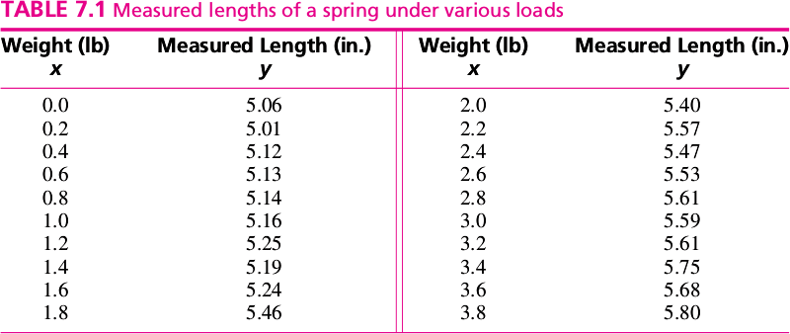
Example

Slide 65
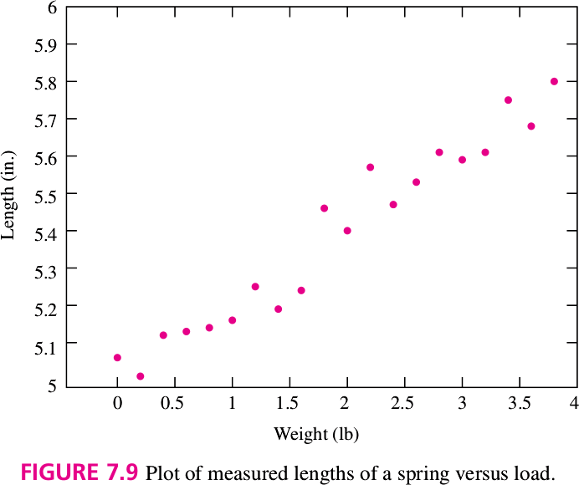

Slide 66
Measurement error ( ε )
i
●
If there were no measurement error, the points would lie on a straight line with slope β 1 and intercept β 0 , and these quantities would be easy to determine.
●
Because of measurement error, β 0 and β 1 cannot be determined exactly, but they can be estimated by calculating the least-squares line.

Slide 67
ε : accumulation of error from many sources
i
In practice, ε_{i} represents the accumulation of error from many sources.
In an experminent about checking the elasiticity of a spring, ε_{i} can be affected by errors in:
measuring the length of the spring,
errors in measuring the weights of the loads placed on the spring,
variations in the elasticity of the spring due to changes in ambient temperature or metal fatigue, and so on.
●
●

Slide 68

Equation of least-squares line
Equation of least-squares line
y_{i} = β^{ˆ} + β^{ˆ} x
0 1
are called least-squares coefficients, estimates of β 0 and β 1

Slide 69
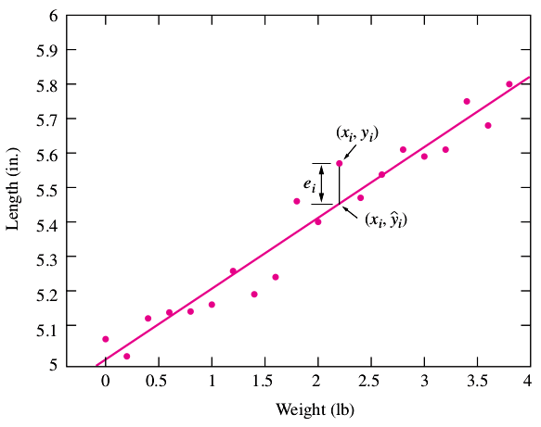
The least-squares line superimposed

Slide 70

Residuals
Fitted value
yˆ_{i}
= β^{ˆ} + β^{ˆ} x
0 1 i
Residual = Observed – Predicted
e_{i} = y_{i} − yˆ_{i} = y_{i} − (β^{ˆ} + β x )
ˆ
0 1 i
The least-squares line is the line that minimizes the sum of the squared residuals, i.e.,

Slide 71
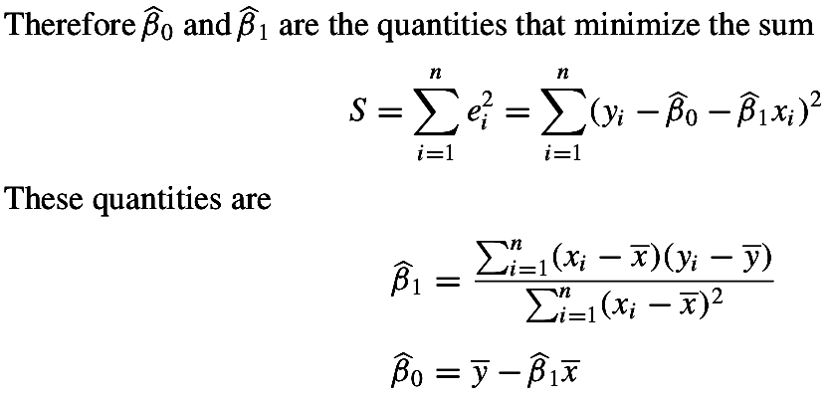
Computing the Equation of the Least-Squares Line
= y_{i} − (β^{ˆ} + β x )
e_{i} = y_{i} − yˆ_{i}
ˆ
0 1 i

Slide 72
Problem
●
An article presents calculations of the ages (in calendar years before 1950) of several sediment samples taken at various depths (in cm) in Lago di Fimon, a lake in Italy. The results are presented in the following table.
Compute the least-squares line for predicting age from depth.
If two samples differ by 100 cm in depth, by how much would you predict their ages to differ?
Predict the age for a specimen whose depth is 600 cm.
For what depth would you predict an age of 5000?

Slide 73
Scatterplot of age (y) versus depth (x).

Slide 74
Points to Ponder
Don't Extrapolate Outside the Range of the Data :
We cannot predict y when x lies outside the range ^{(x}max ^{- x}min⁾
No outliers.
●
●
Don't Use the Least-Squares Line When the Data Aren't Linear

Slide 75
Problem
●
An article presents calculations of the ages (in calendar years before 1950) of several sediment samples taken at various depths (in cm) in Lago di Fimon, a lake in Italy. The results are presented in the following table.
1) Should the least-squares line be used to predict the age for a depth of 50 cm? If so, predict the age. If not, explain why not.

Slide 76
Solution
The least-squares line should not be used to predict the age for a depth of 50 cm as It is outside the range of the data (Outlier)

Slide 77
Problem
Compute the correlation r between the degree of warping and the temperature.
Compute the least-squares line for predicting warping from temperature.
Predict the warping at a temperature of 40 ◦C.
At what temperature will we predict the warping to be 0.5 mm?

Slide 78





a. Compute the correlation r between the degree of warping and the temperature.

Slide 79


b. Compute the least-squares line for predicting warping from temperature.
Least-squares line :

Slide 80
c. Predict the warping at a temperature of 40 ◦C.
Least-squares line :

Slide 81
d. At what temperature will we predict the warping to be 0.5 mm?
Least-squares line :
y = 0.5mm
Let x be the required temperature.
=> x = 24.1◦ C

Slide 82
Measuring Goodness-of-Fit
A goodness-of-fit statistic is a quantity that measures how well a model explains a given set of data.
The correlation coefficient r measures the strength of the linear relationship between x and y.
Therefore r is a goodness-of-fit statistic for the linear model.
●
●
●

Slide 83

Goodness-of-fit statistic
●
The strength of the linear relationship can be measured by computing the reduction in sum of squared prediction errors obtained by using
●
is a
goodness-of-fit statistic.
The bigger this difference is, the more tightly clustered the points are around the least-squares line and the stronger the linear relationship is between x and y.
●

Slide 84
Goodness-of-fit statistic – has units
●
The quantity:
has units, namely the squared units of y.
We could not use this statistic to compare the goodness-of-fit of two models fit to different data sets, since the units would be different.
To measure goodness-of-fit on an absolute scale, we use a different statistic which is unitless, based on r.
●
●

Slide 85

Coefficient of Determination - Unitless

Slide 86
Uncertainties in Regression Coefficients

Slide 87

Uncertainties in the Regression Coefficients
●
Each time the process is repeated, the values of
ε_{i}, and thus the values of different.
In other words, ε_{i} , variables.
, will be
are random
●
if the ε_{i} tend to be small in magnitude, the points will be tightly clustered around the line, and the uncertainty in the least-squares estimates
will be small.
●

Slide 88
The Plot of Residuals versus Fitted Values : Residual plot
Residual = Observed - Predicted(fitted)
A residual plot is a graph that shows the residuals on the vertical axis and the fitted value on the horizontal axis.
●
●
If the points in a residual plot are randomly dispersed around the horizontal axis, a linear regression model is appropriate for the data; otherwise, a non-linear model is more appropriate.
●
Positive values for the residual (on the y-axis) mean the prediction was too low, and negative values mean the prediction was too high; 0 means the guess was exactly correct.

Slide 89
The Plot of Residuals versus Fitted Values : Residual plot
By mathematical necessity:
The residuals have mean 0, and
The correlation between the residuals and fitted values is 0 as well.
The least-squares line is therefore horizontal, passing through 0 on the vertical axis.
●

Slide 90
Transforming the variables
Fixes violations of assumptions and allow the linear model to be used.
Replacing a variable with a function of itself is called transforming the variable. Specifically, raising a variable to a power is called a power transformation.
Taking the logarithm of a variable is also considered to be a power transformation, even though the logarithm is not a power.
●
●
●

Slide 91
Problem
Compute the least-squares line for predicting:
x vs. y
ln x vs. y
x vs. ln y
x vs. sqrt(y)
Print intercept(0) and slope (1) value in each case.
Make a plot of residuals versus fitted values in each case. Which of the four models (1) through (4) fits best? Explain.
●
●
●
●

Slide 92
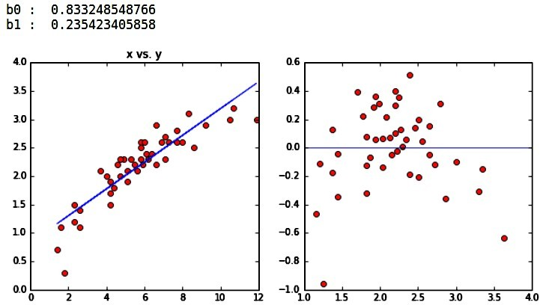
x vs. y

Slide 93
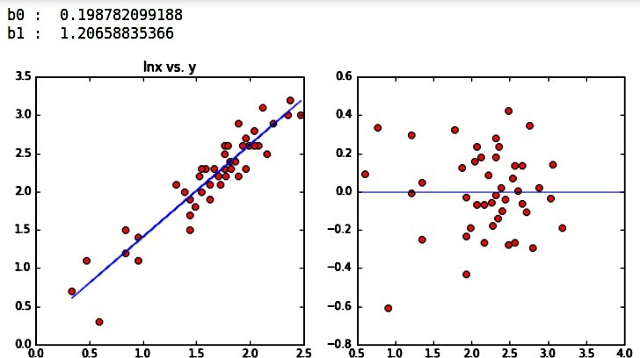
ln x vs. y

Slide 94
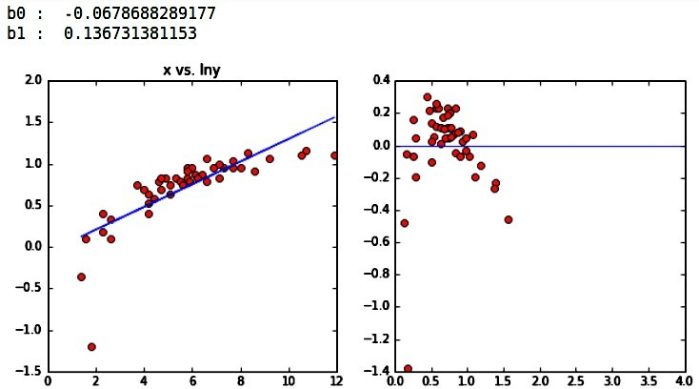
x vs. ln y

Slide 95
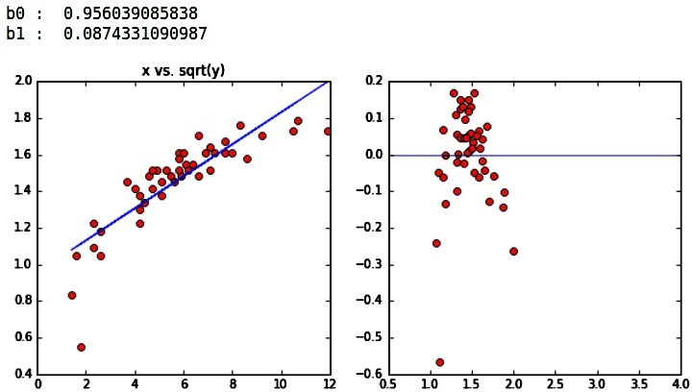
x vs. sqrt(y)

Slide 96
Determining Which Transformation to Apply
●
Proceed by trial and error.
Transformations Don't Always Work
●
Other methods should be used.

Slide 97
Thank you !

